Slide 1



Text
Chocolate

Slide 2


Text
Chocolate
1 Chocolate, which must be one of the world’s most popular foods, first came to Europe in the 16th century from Central America. It is made from the beans of the cacao tree, Theobroma cacao, which means “food of the gods”. The Aztecs used to crush the beans into a paste and add spices to make a stimulating and nourishing drink (or cocoa as it became known). It was used in religious ceremonies and it was so highly valued that even taxes were paid in cocoa beans. When Europeans brought it back from their voyages, they added a sweet flavour, and the drink soon became very popular as an expensive luxury.

Slide 3
Text
2 Solid chocolate as we know it today first appeared in the 1800s. Cocoa beans were crushed into a powder, mixed with a liquid, then heated and poured into a mould, forming shapes as it cooled. The next development was learning how to get cocoa butter from the beans, a process first tried in 1825. The beans were crushed into a paste which was put under high pressure and formed liquid chocolate and cocoa butter. In 1882, Rodolphe Lindt of Switzerland began to add extra cocoa butter to his chocolate, making it smoother. The chocolate sets into bars which will easily snap into pieces and then melt in the mouth. Cocoa butter melts at the same temperature as that of the human body, 97˚F.

Slide 4
Text
3 The world’s best-selling type of chocolate, milk chocolate, which is sweeter and smoother than dark chocolate, didn’t appear until the end of the 19th century. In 1875, another Swiss manufacturer, Daniel Peter perfected the process. A concentrated form of milk, condensed milk, had recently been invented and this was easier to mix with cocoa paste. Dove Chocolate, first manufactured in 1956 by the US company Mars, is now one of the most popular chocolate bars in China.

Slide 5
Text
4 As we know, most people enjoy chocolate. But what accounts for its amazing popularity or even the properties that have made millions of people confess to being chocaholics? Around 40 per cent of women and 15 per cent of men admit to having a very strong feeling of wanting chocolate, especially in the late afternoon and evening. Most of them would agree they have a “sweet tooth”. Scientists know that it can be inherited from our parents and this has been proved in laboratory experiments with mice. If a parent likes chocolate, so does the child. This genetic trait makes us prefer to eat things with a sweet taste.

Slide 6
Text
5 However, it is not just the large amounts of sugar in modern chocolate that explains its success. If this were the case, other products containing sugar would have the same effect on us. We don’t want other sweet foods the way we want chocolate, as they don’t make us feel good in the same way.
6 It is also known that chocolate helps release hormones in the brain called endorphins. These chemicals make us feel happy and give us a sense of well-being, similar to the feeling we have when we’re in love! Although there are about 300 different chemicals in chocolate, including minerals and vitamins, it is not really known how all of these affect us.
■

Slide 7

Text
巧克力
1 巧克力是世界上最受欢迎的食品之一。它最早于16世纪从中美洲引进到欧洲。巧克力是用可可豆做成的。可可豆又称为Theobroma cacao,意思是“天神之粮”。阿兹特克人常常把可可豆捣成酱，再加入调味香料，做成提神醒脑的滋补饮料（也称为可可饮料）。巧克力也用于宗教仪式。由于它极其珍贵，甚至可以用来纳税。当年欧洲的航海探险者带回了巧克力，又往巧克力中加入了香甜的味道，这种饮料随即就作为昂贵的奢侈品受到人们的青睐。

Slide 8
Text
2 我们现在所知道的固体巧克力首次出现在19世纪。可可豆被磨成粉，加入液体搅拌，然后加热，倒入模子，冷却后成形。下一步的发展就是学会如何从可可豆中提取可可油。第一次尝试加工是在1825年。可可豆被碾压成酱，经高压处理，分离成液态巧克力和可可油。1882年，瑞士人鲁道夫·莲开始在巧克力中添加可可油，使之更加柔滑。（添加了可可油后）巧克力凝固成易折断的条块，入口即化。可可油融化的温度和人的体温相同，都是华氏97度。

Slide 9
Text
3 直到19世纪末，世界上最畅销的巧克力——比黑巧克力更香甜柔滑的牛奶巧克力——才问世。1875年，另一位瑞士制造商丹尼尔·彼得完善了巧克力的制作工艺。那时刚刚发明出一种浓缩型的牛奶——炼乳。炼乳易与可可酱溶合。目前中国市场上最畅销的巧克力之一是由美国的玛氏公司于1956年首次研制生产的德芙巧克力。

Slide 10
Text
4 我们知道，大多数人都喜欢吃巧克力。但是，是什么原因使巧克力出奇地畅销？又是什么原因导致了巧克力的上瘾特性，使许多人承认自己是巧克力迷呢？大约有40%的女性和15%的男性承认他们很喜欢吃巧克力。在傍晚和晚上，这种渴望尤其强烈。他们大多数都承认爱吃甜食。科学家们认为这可能是源于父母遗传。这在实验室的老鼠实验中也得到了证实。如果父亲或母亲爱吃巧克力，孩子就爱吃巧克力。这种基因特征使我们更喜欢吃带甜味的东西。

Slide 11
Text
5 但是，巧克力的畅销并不只是由于现代巧克力产品中所含的大量糖分。如果是糖分在起作用的话，那么其他含糖产品就会对我们有同样的影响。但是我们并不像爱吃巧克力那样爱吃别的甜食，因为它们不能给予我们相同的愉悦感。
6 大家也知道，巧克力有助于大脑释放出一种被称为内啡呔的荷尔蒙。这种化学物质让我们感到快乐，给我们幸福感，类似于我们恋爱时的感觉！尽管巧克力中包含大约300种化学物质——其中包含矿物质和维生素，但是，我们还未能确定所有这些物质对我们的身体有何影响。

Slide 12

Words & Phrases
cacao
mould
property
crush
snap
confess
paste
melt
chocaholic
spice
best-selling
sweet tooth
stimulating
manufacturer
inherit
nourishing
concentrated
genetic
cocoa
condense
trait
highly
condensed milk
release
flavour
manufacture
hormone
luxury
popularity
endorphin

Slide 13
Words & Phrases
well-being
account for
vitamin
have an / some / little / no effect on
Theobroma cacao 可可树
Aztec 阿兹特克人（墨西哥印第安人）
Rodolphe Lindt 鲁道夫·莲（人名）
Switzerland 瑞士
Daniel Peter 丹尼尔·彼得（人名）
Dove Chocolate 德芙巧克力（商标名）
Mars 美国玛氏公司

Slide 14
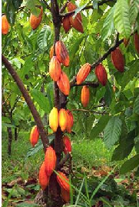
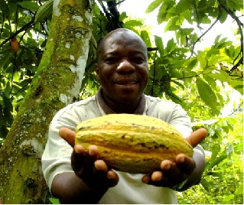


Words & Phrases
cacao n. [U] a tropical tree, the seeds of which are used for making chocolate and cocoa 可可树（热带植物，种子用于制作巧克力及可可粉）
e.g.
1. Chocolate is a product of the tropical cacao trees.
巧克力是热带可可树的一种产物。
2. Some coffee and cacao are grown for export.
种植的咖啡豆和可可豆有些是为了出口。

Slide 15
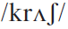
Words & Phrases
crush vt. to press sth. so hard that it breaks into very small pieces 压碎
e.g.
1. The machine can crush rocks into powder.
那台机器能把岩石压成粉末。
2. How many tons of ore can this machine crush in an hour?
这台机器每小时可以破碎多少吨矿石?

Slide 16
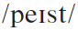
Words & Phrases
paste n. [C, U] a soft thick mixture that can easily be shaped or spread 糊；膏状物
e.g.
1. I like sesame paste.
我喜欢吃芝麻糊。
2. Mix the butter and flour into a paste.
把黄油和面粉调成糊状。

Slide 17
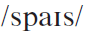
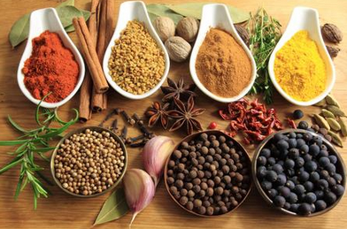
Words & Phrases
spice n. [C, U] a substance made from plants and added to food to give it a particular flavour 香料；调味品
e.g.
1. His father was a dealer in spice.
他父亲以前是香料商人。
2. Pepper, ginger, and nutmeg are spices.
胡椒、姜和肉豆蔻都是调味品。

Slide 18
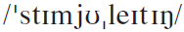

Words & Phrases
stimulating a.
1. making you feel physically active 令人有活力的
e.g. I find swimming the most stimulating form of exercises.
我觉得游泳是最让人充满活力的一项运动。
2. making you feel interested 饶有兴味的
e.g. As a subject, ecology has a lot of stimulating characteristics.
生态学作为一项课题具有许多有趣的特点。

Slide 19
Words & Phrases
Word family: stimulate v.
to encourage an activity to begin or develop further 刺激；促使；促进
e.g. The policy is sure to stimulate economic growth.
这个政策肯定能刺激经济发展。
to encourage sb. by making them excited about and interested in sth. 激发；鼓励；激励
e.g. Imagination is a valuable quality and a motivating power, and stimulates achievement. (CET4-2008-12 )
想象力是一种宝贵的品质，一种激励性的力量，能激励人们取得成就。

Slide 20
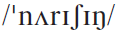
Words & Phrases
nourishing a. providing the food needed to live, grow, and be healthy 滋养的；富有营养的
e.g.
1. Milk is a nourishing drink.
牛奶是一种富有营养的饮品。
2. All the ups and downs of life are nourishing experiences for our growth.
人生的起起落落，都是成长的经验。
Word family: nourish vt.
e.g. A great variety of animals nourish themselves on vegetable foods.
多种动物依靠素食生存。

Slide 21
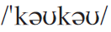
Words & Phrases
cocoa n.
1. [U] a brown powder made from cocoa beans that is used for making chocolate or chocolate-flavoured foods and drinks 可可粉
e.g. The Ivory Coast became the world’s leading cocoa producer.
象牙海岸成了世界上领先的可可粉生产地。

Slide 22
Words & Phrases
cocoa n.
2. [C, U] a hot chocolate-flavoured drink made from milk, cocoa, and sugar, or a cup of this drink 可可饮料；一杯可可饮料
e.g. There is nothing as good as a piping hot cup of cocoa on a cold winter’s evening.
在寒冬的夜晚，没有什么东西能一杯比滚热的可可茶更好的了。

Slide 23
Words & Phrases
highly ad.
1. very or very well 极；非常
e.g. Keep your expectations for your children reasonable. Many highly successful men never attended Harvard or Yale. (CET4-2003-12 )
对孩子们的期望要合理。很多非常成功的人从未上过哈佛或耶鲁。
2. to a high level or standard 高度地；高水平
e.g. She is a highly educated woman.
她是个受过高等教育的女子。

Slide 24
Words & Phrases
3. speak / think highly of: to tell other people how good sb. is at sth. or think they are very good at sth. 高度称赞/评价
e.g.
1. After being a pastor for some time, he began to think highly of himself.
在成为牧师多年之后，他开始出现自我膨胀的倾向。
2. The man did not think highly of Alice’s presentation. (CET4-2005-12)
这个人对爱丽丝的报告评价不高。

Slide 25
Words & Phrases
flavour n.
1. [C] the particular taste that food or drink has 味；味道；滋味；风味
e.g. Adding salt to food improves the flavor.
食物中加盐可以提味。
2. [sing. U] an idea of what sth. is like 风格；风味；风韵
e.g. This newspaper has a sporting flavour.
这份报纸具有体育特色。

Slide 26
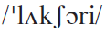
Words & Phrases
luxury
1. n. [C] sth. expensive that you enjoy but do not really need 奢侈品
e.g. A refrigerator was then a luxury.
那时候冰箱是一种奢侈品。
2. a. very expensive and of the highest quality 奢华的；豪华的；高档的
e.g. The Smiths live in a very luxury flat in central London.
史密斯一家住在伦敦中心区的一处高档公寓里。

Slide 27
Words & Phrases
Word family：luxurious a.
e.g. The luxurious liner is cleaving through the waves.
这艘豪华邮轮正在破浪前进。
Cf. luxury & luxurious
e.g. Trains were fast, very luxurious, and quite convenient compared to other forms of transportation existing at the time. (CET4-2000-1)
和当时其他的交通手段相比，火车速度快，非常奢华，而且相当方便。
Luxury and luxurious are basically the same. Both of them can be used to modify nouns. The difference is luxurious sometimes is used as a predicative.

Slide 28
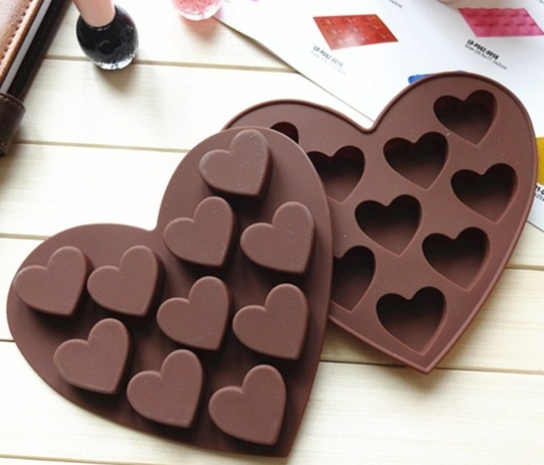
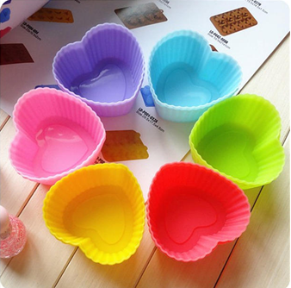
Words & Phrases
mould n. [C] a hollow container that you pour liquid into, so that when the liquid becomes solid, it takes the shape of the container 模子；铸模；模型
e.g. a chocolate (pudding) mould
巧克力（布丁）模子
The followings are various chocolate moulds:

Slide 29
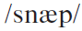
Words & Phrases
snap v.
1.
2.
3. to speak to sb. in a sudden, angry way 急速地说；厉声说
to suddenly break sth. with a short loud noise, or to be broken in this way（使）咔嚓一声断裂
to suddenly lose control and become extremely angry or upset because a situation has become too annoying or difficult（精神等）崩溃；突然失控

Slide 30
Words & Phrases
Work in pairs. Figure out the meanings of the underlined words. Match its usage with the meaning.
1（使）咔嚓一声断裂 2（精神等）崩溃；突然失控
3 急速地说；厉声说
1. The branch snapped under the weight of the snow.
2. He tends to snap at people when he’s got a headache.
3. My nerves finally snapped under the pressure of work.
4. She snapped off a piece of chocolate.
1
3
2
1

Slide 31
Words & Phrases
melt
1. v. if sth. solid melts or if heat melts it, it becomes liquid （使）融化；（使）熔化
2. vi. to disappear, usually gradually（逐渐地）消失
Translate the following sentences into Chinese.
1. The sun melted the snow. ( vt.)
阳光使雪融化。
2. Glass melts at a high temperature. ( vi. )
玻璃在高温下熔化。
3. Her anger melted at his kind words. ( vi. )
听了他亲切的话语，她的愤怒消失了。

Slide 32
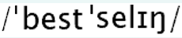
Words & Phrases
best-selling a. (only before noun) a best-selling book, record etc. is very popular and has been bought by a large number of people （书、唱片等）畅销的
e.g.
1. The Best-selling book Men Are From Mars, Women Are From Venus is headed for the big screen.
畅销书《男人来自火星，女人来自金星》将被搬上大银幕。
2. She managed to launch a best-selling book with the same name and deserved every bit of praise she received.
她成功地出版了一本和畅销书同名的书，对她所有的称赞，她都当之无愧。
Word family: best-seller n. 畅销书；畅销唱片

Slide 33
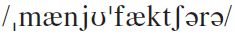
Words & Phrases
manufacturer n. [C] a company that makes large quantities of goods 制造商；厂商
e.g.
1. American auto manufacturers are using quality improvement as one way to recapture world markets. (CET4-2001-6)
美国汽车制造商正把提高质量作为收复世界市场的一种办法。
2. Henry Ford, the famous US inventor and car manufacturer, once said, “The business of America is business.” (CET4-2003-6)
美国著名发明家和汽车制造商亨利·福特曾说：“美国人的头等大事就是做买卖”。
See also: manufacture

Slide 34
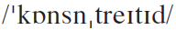
Words & Phrases
concentrated a. concentrated liquids or substances have been made stronger by having water removed 浓缩的；脱水的
e.g.
1. The liquid is found in a highly concentrated form.
人们发现这种液体呈高度浓缩状。
2. Sweeten dishes sparingly with honey, or concentrated apple or pear juice.
用少许蜂蜜或浓缩苹果汁或梨汁使菜肴变甜。
Word family: concentrate v. concentration n.

Slide 35
Words & Phrases
condense v. if gas or steam condenses, or if sth. condenses it, it changes into a liquid（使）凝结；（使）冷凝
e.g.
1. The drop in temperature condensed the steam to water.
温度下降使蒸汽凝成了水。
2. Condense the mixture by boiling off some of the liquid.
通过煮沸，蒸发掉一些液体，使混合液浓缩。
See also: condensed milk

Slide 36
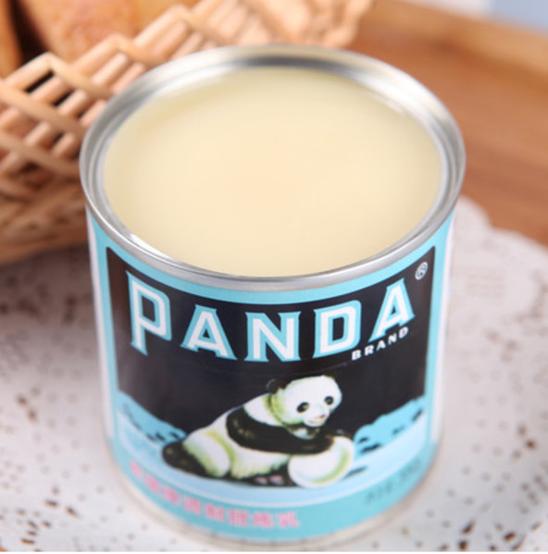
Words & Phrases
condensed milk n. [U] a type of thick sweet milk sold in cans 炼乳
e.g.
1. The tea was sweetened with a hoarded tin of condensed milk.
用贮藏的一罐炼乳为茶添加了甜味。
2. She does not drink water but likes condensed milk.
她不喝水，但是喜欢炼乳。
See also: condensed

Slide 37
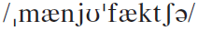
Words & Phrases
manufacture vt. to make goods in large quantities in a factory（大量）生产，制造
e.g.
1. It is manufactured by hand.
这是手工制造的。
2. This kind of glasses manufactured by experienced craftsmen wears comfortably. (CET4-2000-1)
这种由富有经验的匠人制作的眼镜戴起来非常舒适。
3. Back in 1984 we discovered that most manufactured products for decoration weren’t designed for indoor use. (CET4-2006-6)
在1984年，我们发现大多数制造的装饰品都不是为室内使用设计的。
See also: manufacturer

Slide 38
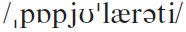
Words & Phrases
popularity n. [U] a situation in which sb. or sth. is popular with many people 流行；普及
e.g.
1. At one point, though, instant coffee grew rapidly in popularity, and many brands were introduced. (CET4-2001-6)
但是，速溶咖啡曾一度迅速普及，推出了很多品牌。
2. The comedian enjoyed great popularity during the 30’s.
那位喜剧演员在三十年代非常走红。

Slide 39
Words & Phrases
Word family: popular a.
Translate the following sentences into Chinese.
1. Beer is the most popular drink among male drinkers, whose overall consumption is significantly higher than that of women. (CET4-2000-6)
啤酒在男性饮酒者中最受欢迎，他们的总消费量大大高于女性饮酒者。
2. There are signs that restaurants are becoming more popular with families. (CET4-2000-6)
有迹象显示，餐馆正越来越受到家庭喜爱。

Slide 40
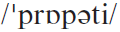
Words & Phrases
property n.
1. [C] (usu. pl.) a quality or feature of sth. 特性；特质
e.g.
1. A radio signal has both electrical and magnetic properties.
无线电信号既具有电的特性也具有磁的特性。
2. Cheerfulness is a property of her personality.
开朗乐观是她的性格特征。

Slide 41
Words & Phrases
2. [U] things, esp. valuable things, that are owned by sb. 所有物；财产；资产
e.g.
1. Certain kinds of property are transferred automatically at death.
死亡时某些财产会自动转让。
2. A patent protects your intellectual property.
专利能保护你的知识产权。
3. They decided to levy on his property to pay his debts.
他们决定扣押他的财产以偿付他的债务。

Slide 42
Words & Phrases
confess v.
1. to admit sth. about yourself that you would not normally tell people because you are embarrassed about it or they could be disappointed by it 承认（尴尬或令人失望的事）
2. to admit that you have committed a crime 承认；供认；招供；交代
Word family: confession n.

Slide 43
Words & Phrases
Translate the following sentences into Chinese:
1. Mary confessed that she didn’t really know how to work the computer.
玛丽承认她其实并不会使用电脑。
2. He confessed to having a secret admiration for his opponent.
他承认私下里很佩服他的对手。
3. After three hours of questioning the suspect broke down and confessed.
经过三个小时的审讯，嫌疑犯崩溃了，招认了一切。

Slide 44
Words & Phrases
Look at the following sentence and choose the best answer.
The man in the corner confessed to ______ a lie to the manager of the company. (CET4-1997-6)
A. have told
B. be told
C. being told
D. having told
D

Slide 45
Words & Phrases
chocaholic n. [C] sb. who loves chocolate, and eats a lot of it 嗜吃巧克力的人
-aholic suffix ( in nouns and adjectives ) (infml) sb. who cannot stop doing sth. or using sth. 构成名词和形容词 对…痴迷的（人）；沉湎于…的（人）
1. a workaholic
one who likes working and cannot stop 工作狂
2. a shopaholic
one who likes shopping and cannot stop 购物狂
3. an alcoholic
someone who regularly drinks too much alcohol and cannot stop 酗酒者；嗜酒成瘾者

Slide 46
Words & Phrases
sweet tooth n. [sing] sb. who has a sweet tooth likes to eat sweet food 对甜食的爱好
e.g.
1. Fruit is a good substitute for candy if you have a sweet tooth.
如果你喜好甜食，水果是糖果的绝佳替代品。
2. Some say the Roman emperor Nero invented ice cream to satisfy his sweet tooth.
有人说，罗马皇帝尼禄为了满足自己对甜食的喜好而发明了冰淇淋。

Slide 47
Words & Phrases
inherit
1. vt. to be born with the same appearance or character as one of your parents 经遗传而得（相同的外貌或特征）
e.g. She inherits her blues eyes from her father.
她遗传了父亲的蓝眼睛。
2. v. to receive property or money from sb. who has died 继承（财产）
e.g. She inherited the land from her grandfather.
她从祖父那里继承了土地。

Slide 48
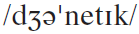
Words & Phrases
genetic a. relating to genes and the study of them 基因的；遗传学的
e.g.
1. The offspring contain a mixture of the genetic blueprint of each parent.
子女身上遗传了父母双方的基因蓝图。
2. These abnormalities may have a genetic basis.
这些畸形可能和基因有关。
Word family: gene n. 基因
genetics n. 遗传学

Slide 49
Words & Phrases
trait n. [C] a particular quality in sb.’s character 个性特征；品质
e.g.
1. Aggression is by no means a male-only trait.
好斗绝非男性才具有的特征。
2. Her generosity is one of her most pleasing traits.
慷慨大方是她最讨人喜欢的性格特点之一。

Slide 50
Words & Phrases
release vt.
1. to let a substance or energy spread into the area or atmosphere around it, esp. as part of a chemical reaction （尤指化学反应中）释放（物质或能量）
2. to let sb. leave a place where they have been kept 释放；放出
3. to let news or official information be known and printed 发布；公开发表
4. to express or get rid of feelings such as anger or worry 表达；发泄

Slide 51
Words & Phrases
Work in pairs. Figure out the meanings of release in each sentence. Match its usage with the meaning.
1 释放；放出；2 发布；公开发表
3 表达；发泄；4 释放（化学品）
The names of the delegates were not released to the press. ( )
Physical exercise is a good way of releasing tension. ( )
It is dangerous to release radioactive matter into the environment. ( )
He was released from a hospital last week after treatment for a disease. ( )
2
3
4
1

Slide 52
Words & Phrases
hormone n. [C] a chemical substance produced in animals and plants that controls things such as growth and sexual development 激素；荷尔蒙
e.g.
1. Over secretion of the male hormone can also result in thinning hair.
雄性激素分泌过多也会导致头发稀疏。
2. Stress prompts the body to produce certain stress hormones. (CET4-2005-12)
压力促使身体产生某种压力荷尔蒙。

Slide 53
Words & Phrases
endorphin n. [C] (medical) a type of hormone produced in the body that reduces pain, esp. when you are injured or physically tired 内啡肽（体内产生的一种有镇痛作用的荷尔蒙）
e.g.
1. Exercise can be a great way to relieve stress, releasing endorphin which will improve your mood.
体育锻炼是一种减轻压力、释放内啡肽的好方法，它能让你心情变好。
2. With its ability to boost “feel-good” endorphin levels, chocolate has long been used as a mood-lifter.
凭借其提高“感觉良好”内啡呔浓度的能力，巧克力一直被用来提高情绪。

Slide 54
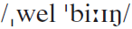
Words & Phrases
well-being n. [U] the satisfactory state that sb. or sth. should be in, that involves such things as being happy, healthy, and safe, and having enough money 幸福；安康；富裕
e.g.
1. Singing can create a sense of well-being.
唱歌能产生一种幸福感。
2. Controlling stress is not only important for your overall happiness and well-being, but for your health as well.
控制压力不仅仅对你所有的快乐与幸福至关重要，对你的健康也是如此。

Slide 55
Words & Phrases
vitamin n. [C] natural substances found in food that are necessary to keep your body healthy. Each vitamin is given a name using a letter of the alphabet, for example vitamin C which is found in many fruit and vegetables. 维生素；维他命
e.g.
1. Milk is rich in vitamins.
牛奶富含维他命。
2. Lack of vitamin A can cause blindness.
缺乏维生素A会导致失明。

Slide 56
Words & Phrases
account for
1. to be the reason why sth. exists or happens 是…的原因；引起；导致
2. to give an explanation for sth. bad that has happened, esp. sth. you are responsible for 对（尤指所负责之事）作出解释（或说明）
3. to cause, to result in 导致；引起
4. to form, to use, or to produce a particular amount or part of sth. （在数量或比例上）占；占据

Slide 57
Words & Phrases
Translate the following sentences into English:
1. 他因为生病, 所以才缺席。
His illness accounted for his absence.
2. 这占了全部铁道事故的30%。
It accounts for 30 per cent of the whole railway accidents.
3. 总裁被叫到理事会对他的行为作出解释。
The president was called before the board to account for his actions.
4. 太多的雨水导致庄稼歉收 。
Too much rain accounted for the poor crop.

Slide 58
Words & Phrases
have an / some / little / no effect on: to have some / little / no influence on 对…有一些 / 很少 / 没有影响
e.g.
1. This had a great effect on the future of both mother and son.
这对于母亲和儿子的未来具有很大影响。
2. Politicians do have some effect on the lives of ordinary people.
政治家们对于普通人的生活确实具有影响。
3. The law has no effect on the stability of the city.
这条法律对于城市稳定没有影响。

Slide 59
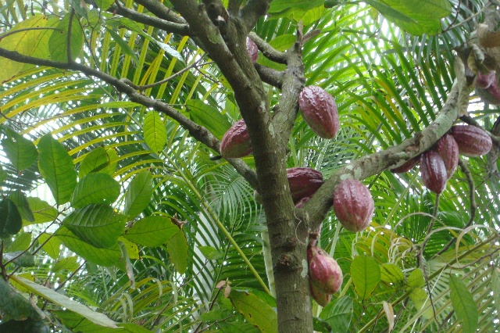
Words & Phrases
Theobroma cacao 可可树
Theobroma cacao, also cacao tree and cocoa tree, is a small evergreen tree, native to the deep tropical region of the Americas. Its seeds are used to make cocoa powder and chocolate.

Slide 60
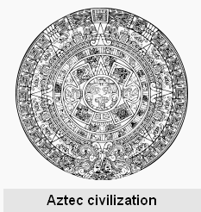
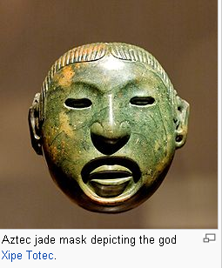
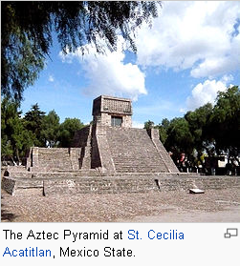
Words & Phrases
Aztec n. the Aztecs were natives of Mexico who were conquered by the Spanish in 1521 阿兹特克人（墨西哥印第安人）

Slide 61
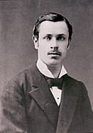
Words & Phrases
Rodolphe Lindt 鲁道夫·莲（人名）
Rodolphe Lindt (1855-1909) founded a chocolate factory in Bern in 1879. He developed two important improvements in manufacture which made his chocolate much smoother and less bitter than that of its rivals, as well as being easier to mould.

Slide 62
Words & Phrases
Switzerland 瑞士 （欧洲中部国家）
Switzerland lies at the centre of western Europe geographically, but outside it politically. Sometimes called Europe’s water tower, it is the source of all four of the region’s major river systems: the Po, the Rhône, the Rhine, and the Inn-Danube.
Switzerland has built one of the world’s most prosperous economies, aided by the fact that it has retained its neutral status through every major European conflict since 1815. The process of European integration has been the latest and strongest challenge to Swiss neutralism, but it remains outside the EU.

Slide 63
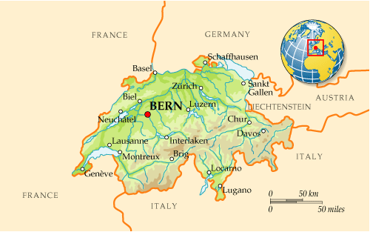
Words & Phrases

Slide 64
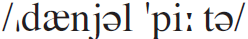
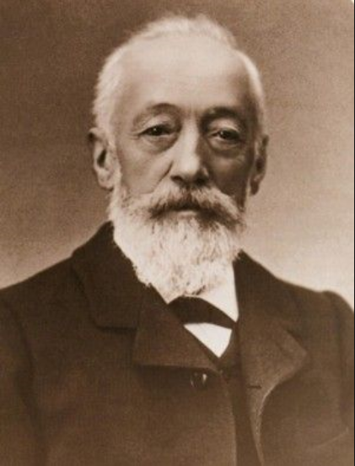
Words & Phrases
Daniel Peter 丹尼尔·彼得（人名）
Daniel Peter (1836-1919) was a famous Swiss chocolatier. He was the first person to make milk chocolate bars, in 1875. He began his career as a candle maker, but soon the demand fell due to the emergence of oil lamps.

Slide 65
Words & Phrases
Daniel Peter 丹尼尔·彼得（人名）
He invented the process of making milk chocolate in 1857. He had a problem with removing the water from the milk and with the cooperation of Henri Nestlé, a baby food manufacturer, he was able to finally bring the product into the market in 1875, after seven years of working on it. The two went on to form the Nestlé Company in 1879.

Slide 66
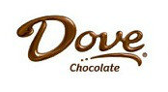
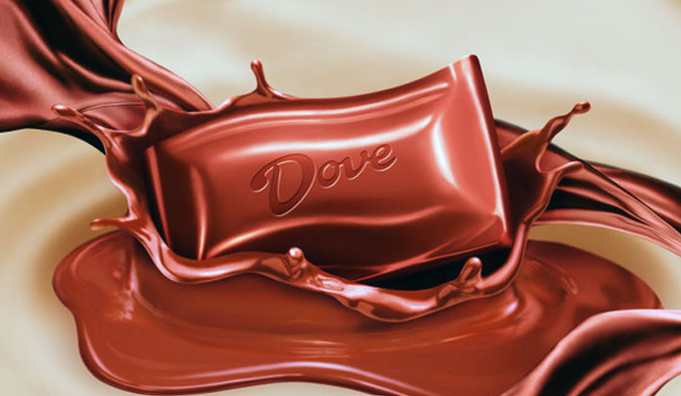
Words & Phrases
Dove Chocolate
Dove is a brand of chocolate made and marketed by the Mars Company. 德芙巧克力（商标名）

Slide 67
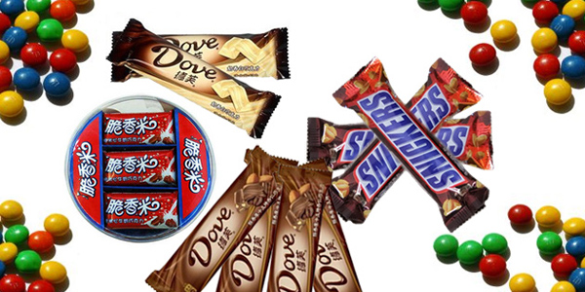
Words & Phrases
Mars Mars is one of the biggest manufacturers of chocolate bars in the world. 美国玛氏公司（成立于1911 年，全球最大的食品生产商之一）

Slide 68


Language Points
… it was so highly valued that even taxes were paid in cocoa beans.
In different cultures there have been many different ways in which people pay taxes. In ancient China, taxes were once paid in grain. In Britain, sheep or cattle were once used. Here, the Aztecs paid taxes in cocoa beans, which showed how the beans were considered important.
翻译：
……由于它极其珍贵，甚至可以用来纳税。

Slide 69
Language Points
But what accounts for its amazing popularity or even the properties that have made millions of people confess to being chocaholics?
Many people admit that they are chocaholics. Here the writer asks about the reason why chocolate is so popular and what special characteristics it may have.
翻译：
但是，是什么原因使巧克力出奇地畅销？又是什么原因导致了巧克力的上瘾特性，使许多人承认自己是巧克力迷呢？

Slide 70
Language Points
We don’t want other sweet foods the way we want chocolate …
The way here means in the way, in is often omitted.
e.g. If you had done the experiment the way your tutor had told you, you would have succeeded.
如果你按照导师所说的方法做实验，你早就成功了。
翻译：
但是我们并不像爱吃巧克力那样爱吃别的甜食……

Slide 71
Language Points
These chemicals make us feel happy and give us a sense of well-being …
a sense of well-being: a satisfactory state that sb. may feel that they are in, such as feeling happy, healthy, safe, or having enough money etc.
翻译：
这种化学物质让我们感到快乐，给我们幸福感……

Slide 72

Exercises
Reading and understanding
Dealing with unfamiliar words
Reading and interpreting
Developing critical thinking

Slide 73
Exercises
Reading and understanding
3 Answer the questions.
1 What are the similarities and differences between chocolate today and chocolate made by the Aztecs?
2 Why was chocolate a luxury in the time of the Aztecs as well as when it was brought to Europe?
3 How was solid chocolate made?
4 Cocoa butter melts at the same temperature as that of the human body. Does this explain why we like chocolate?
5 What aspects of chocolate interest scientists?

Slide 74
Exercises
1
What are the similarities and differences between chocolate today and chocolate made by the Aztecs?
Similarities:
Differences:
In both cases the cocoa beans are crushed and mixed with something to form a paste.
The Aztecs made chocolate with spices, but today’s chocolate is sweet. Aztec chocolate was liquid, but most chocolate today is solid. Aztec chocolate was made purely from crushed beans and spices, but today cocoa butter and condensed milk are added.

Slide 75
Exercises
2
3 How was solid chocolate made?
Why was chocolate a luxury in the time of the Aztecs as well as when it was brought to Europe?
The passage implies that chocolate was a luxury because it was highly valued. The Aztecs paid taxes in cocoa beans, and for the Europeans it was expensive after the long sea voyage from Central America.
Cocoa beans were crushed into a powder, mixed with a liquid, then heated and poured into a mould, forming shapes as it cooled.

Slide 76
Exercises
4 Cocoa butter melts at the same temperature as that of the human body. Does this explain why we like chocolate?
No. The passage suggests there may be a genetic trait for liking chocolate. It talks about endorphins and other chemicals, but it does not make a clear connection between the melting temperature of cocoa butter and the reason why people like chocolate.

Slide 77
Exercises
5 What aspects of chocolate interest scientists?
The answer is implied. Scientists may be interested in learning more about genetic traits to see if some people are specifically prone to like chocolate. More likely, scientists are interested in the effects of the 300 or so different chemicals in chocolate. We can guess that they may also be interested in developing new kinds of chocolate, or finding out more about the social and psychological aspects about chocolate.

Slide 78
Exercises
Dealing with unfamiliar words
4 Complete the sentences with the correct form of the words and expressions below.
5 Replace the underlined words with the correct form of the words below. You may need to make other changes.

Slide 79
Exercises
4 Complete the sentences with the correct form of the words and expressions below.
account for confess crush inherit manufacture
melt property release stimulating
1 Chocolate can be easily ________ so it can be drunk as well as eaten.
2 Certain _________ of chocolate make us feel happy.
3 How do we __________ the fact that 40 per cent of women and 15 per cent of men admit to loving chocolate?
4 The Aztecs found they were _________ by the cocoa drink they made from the crushed beans.
melted
properties
account for
stimulated

Slide 80
Exercises
account for confess crush inherit manufacture
melt property release stimulating
5 I have to ________ that I eat chocolate at least once a day.
6 Originally, the cacao bean was ________ and mixed with a liquid.
7 I never ________ my father’s love of sweet things.
8 The Swiss are well known for _____________ chocolate.
9 Other sweet foods don’t ________ the same chemicals as chocolate.
confess
crushed
inherit
manufacturing
release

Slide 81
Exercises
5 Replace the underlined words with the correct form of the words below. You may need to make other changes.
condense flavour genetic luxury manufacturer
mould nourishing popularity snap trait
For a (1) product which you enjoy but don’t really need, chocolate is extremely (2) beneficial to your health. Chocolate as we know it today first appeared in the 1800s, when liquid chocolate was poured into a (3) shaped container to cool and become solid.
(1) ________ (2)_________ (3) ________
luxury
nourishing
mould

Slide 82
Exercises
condense flavour genetic luxury manufacturer
mould nourishing popularity snap trait
Then the chocolate (4) maker Lindt discovered how to make chocolate (5) break easily by adding extra cocoa butter, and Daniel Peter first made milk chocolate using milk which had been (6) concentrated and then mixed with cocoa paste, which gave it a smoother (7) taste. But the (8) broad appeal of chocolate is the effect of both an (9) inherited (10) characteristic and the 300 chemicals it contains, including vitamins.
(4) ___________ (5) ________ (6) _________ (7) _______
(8) ________ (9) _______________ (10) _______
manufacturer
snap
condensed
flavour
popularity
genetic (a genetic)
trait

Slide 83
Exercises
Reading and interpreting
6 Work in pairs and answer the questions about the features of the passage.
7 Work in pairs. Match the features with the text types in Activity 6. Now discuss which of these features you can see in the passage.

Slide 84
Exercises
6 Work in pairs and answer the questions about the features of the passage.
1 Does it contain critical opinions?
2 Does it refer to a film, a play, or a concert?
3 Does it contain instructions on how to make a certain dish?
4 Are there lots of passive structures?
5 Is it written in formal and objective English?
6 Is it written for specialist readers?
7 Is it written to inform or to entertain, or both?

Slide 85
Exercises
1 Does it contain critical opinions?
Not really. The passage quotes the results of a social survey, but not critical opinions.
2 Does it refer to a film, a play, or a concert?
No, it doesn’t refer to any of these.
3 Does it contain instructions on how to make a certain
dish?
No, the first two paragraphs describe several ways to make chocolate, but they are part of a report rather than instructions.

Slide 86
Exercises
4 Are there lots of passive structures?
There are some examples: It is made …; It was used …; Cocoa beans were crushed …; It is also known …; it is not really known … But such passive structures are not of a high percentage.

Slide 87
Exercises
5 Is it written in formal and objective English?
No, mostly informal language is used, eg there are many short sentences and simple sentences, few complex sentences, a rhetorical question (“But what accounts for its amazing popularity …?”), an exclamation (“… similar to the feeling we have when we’re in love!), contractions (didn’t, don’t).

Slide 88
Exercises
5 Is it written in formal and objective English?
The use of we and us helps readers to identify with the opinions of the writer (“As we know …”; “We don’t want other sweet foods the way we want chocolate, as they don’t make us feel good in the same way”; “These chemicals make us feel happy and give us a sense of well-being, similar to the feeling we have when we’re in love!”). However, the passive structures are more formal.

Slide 89
Exercises
6 Is it written for specialist readers?
No, if it is written for specialist readers it would have more specific details, more technical vocabulary and background knowledge.
7 Is it written to inform or to entertain, or both?
It is written both to inform and to entertain. The passage not only contains historical and manufacturing information, but also entertains with general ideas about wanting chocolate and genetic traits (this part is not really informative because there are no real details). The comment at the end comparing the sense of well-being from eating chocolate to being in love is more entertaining than informative.

Slide 90
Exercises
Now choose where you might see the passage.
(a) In a recipe book.
(b) In a movie review.
Not likely. There are not enough details about making chocolate and no instructions for using it in cooking.
Highly unlikely. There is no information about a film or storyline as one would expect, even for a film in which chocolate is a major theme.

Slide 91
Exercises
(c) In a general interest magazine.
(d) In a scientific report.
Very likely. The information is broad, without many specific details. There are several switches in focus (from history, manufacturing, reasons for the popularity of chocolate to general science) which may keep casual readers interested.
Not likely. There are no details of a research investigation (purpose, hypothesis, research methods, results etc).

Slide 92
Exercises
7 Work in pairs. Match the features with the text types in Activity 6. Now discuss which of these features you can see in the passage.
A recipe book contains instructions on how to make a certain dish.
A movie review contains critical opinions about a film or play.
A general interest magazine is written to inform, to entertain, or both.
A scientific report has lots of passive structures. It is written in formal and objective English, for specialist readers.

Slide 93
Exercises
In the passage there are features of both informal and formal English, and it is written both to inform and entertain. These are the features of a general interest magazine:
a connection with popular lifestyles (the most popular foods; the world’s best-selling type of chocolate; amazing popularity)
a brief background: the history of chocolate manufacturing, which contains information probably unknown to most people (“… even taxes were paid in cocoa beans.”)

Slide 94
Exercises
personal appeals to readers (“As we know …”) with an exclamatory reference to emotion (“… similar to the feeling we have when we’re in love!”)
short, punchy or evocative vocabulary (mix; set; snap; melt; chocaholic; a sweet tooth)
oversimplified references to science (There are no details of any surveys about people who confess to being chocaholics.)

Slide 95
Exercises
Developing critical thinking
8 Work in pairs and discuss the questions.
1 Do you agree that chocolates give you a similar feeling to when you’re in love?
2 Forrest Gump said “Life is a box of chocolates. You never know what you’re gonna get.” How do you understand his words?

Slide 96
Exercises
1 Do you agree that chocolates give you a similar feeling to when you’re in love?
I suppose it could feel similar if it is pleasurable.
No, I don’t agree, because I never experience this effect when I eat chocolate.

Slide 97
Exercises
2 Forrest Gump said “Life is a box of chocolates. You never know what you’re gonna get.” How do you understand his words?
A box of chocolates contains a variety of different types of chocolates, each with a different flavour or shape. When you pick a chocolate, you don’t know whether you will like it or not. The saying means that life is similar in this way — it’s unpredictable and full of surprises, both good and bad.

